Slide 1
SPL – 1 Midterm Presentation
Prepared by:
Mohammad Ismail Hossain
BSSE - 1433
Topic:
Typing Master: An Interactive Typing Tutor and Typing Game
Supervised by:
Dr. Emon Kumar Dey

Slide 2
Project Outline
“Typing tutor and Typing Game” project is an interactive application that aims to improve users’ typing skill through 3 major features.
Typing Tutorial feature provides some technique and helpful rules for fast typing
Practice mode gives users an opportunity to improve typing skill thorugh some structured exercise like key practice, word practice.
Typing Game feature adds a fun and interesting experience for users to test their accuracy and speed in an exciting game environment.

Slide 3
Register System
Login System
Users’ Performance Tracking
Speed Test
Accuracy Test
Game Development
Performance Analysis
Regression Modeling
The Problems and Challenges

Slide 4
Progress till today

Slide 5
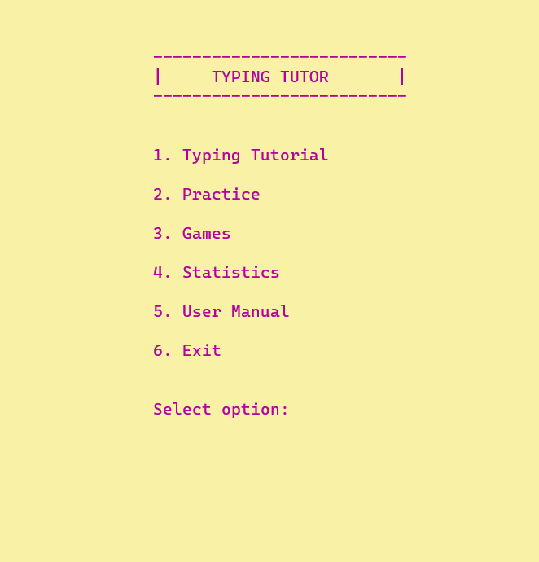
Main Menu
Users can select their desired part.

Slide 6
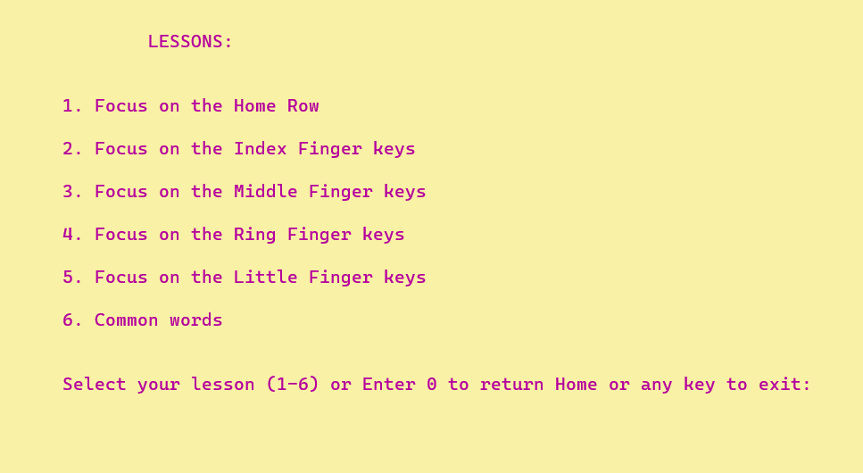
Typing Tutorial
To give a good learning experience, typing tutorial part is divided into 6 part. All the keys (a to z) have been classified into 5 lesson depending on the preferred finger for type the key. Thus user can easily remember the key rhythm. Lastly a feature added which provides some common words to practice.

Slide 7
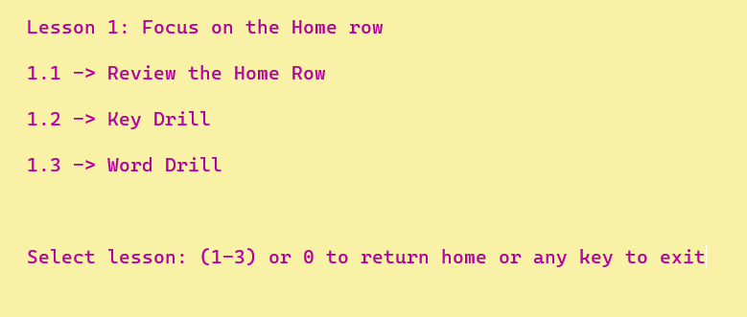
Feature in each Lesson
Each Lesson provides 3 major features.
User can get interactive techniques of typing like proper finger placement, hand positioning, typing posture etc from the review Row part.
Users can practice typing through key typing and word typing. All the alphabet and word are totally randomly generated.

Slide 8
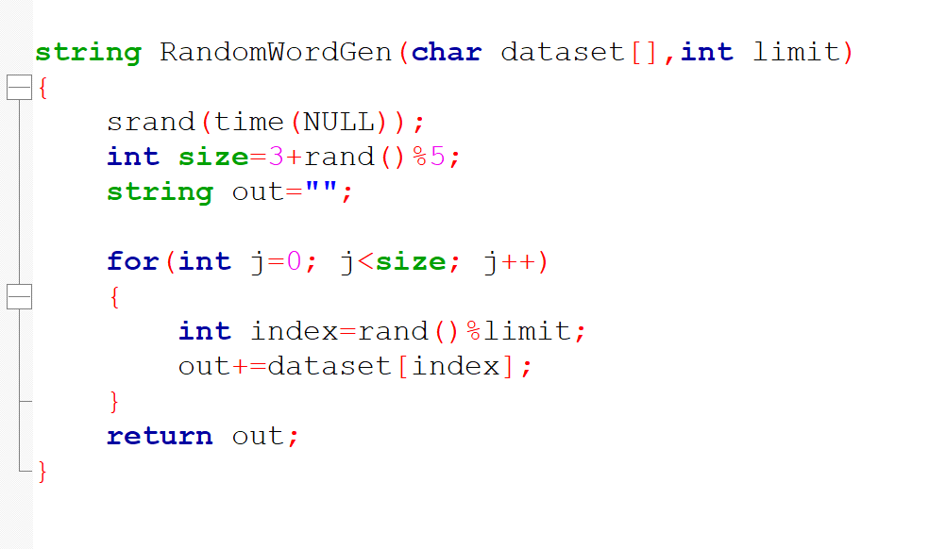
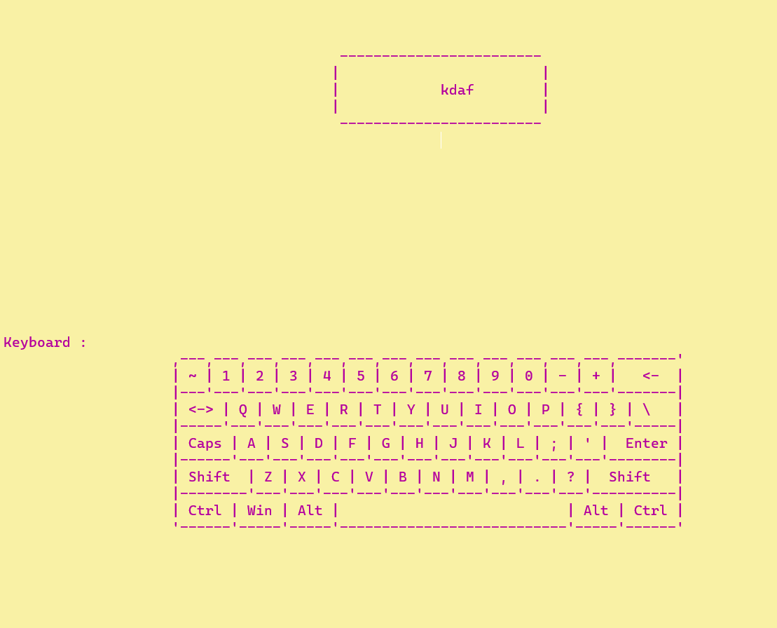
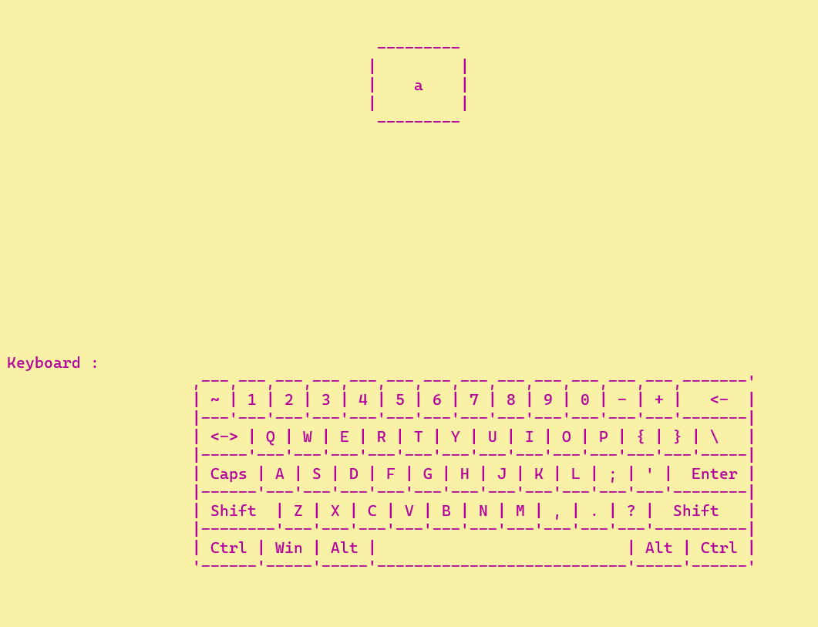
Random Word Generate
One of the most important functionalities in my project was to generate a random word / alphabet.

Slide 9
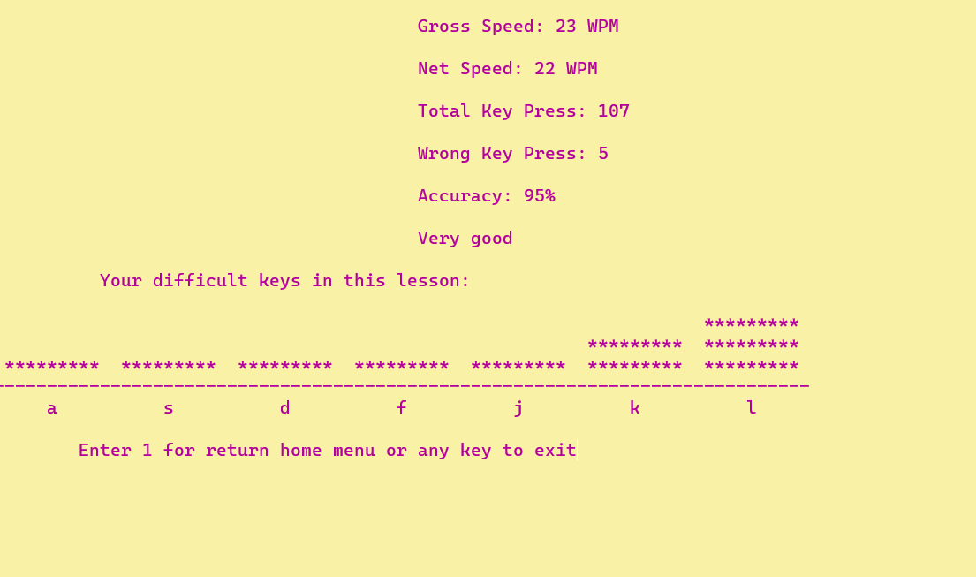
Performance Result
Based on the users performance some analysis will be given.
Gross Speed
Net Speed
Total Key Press
Wrong Key Press
Accuracy
Comment
Difficult Key Analysis using Histogram

Slide 10
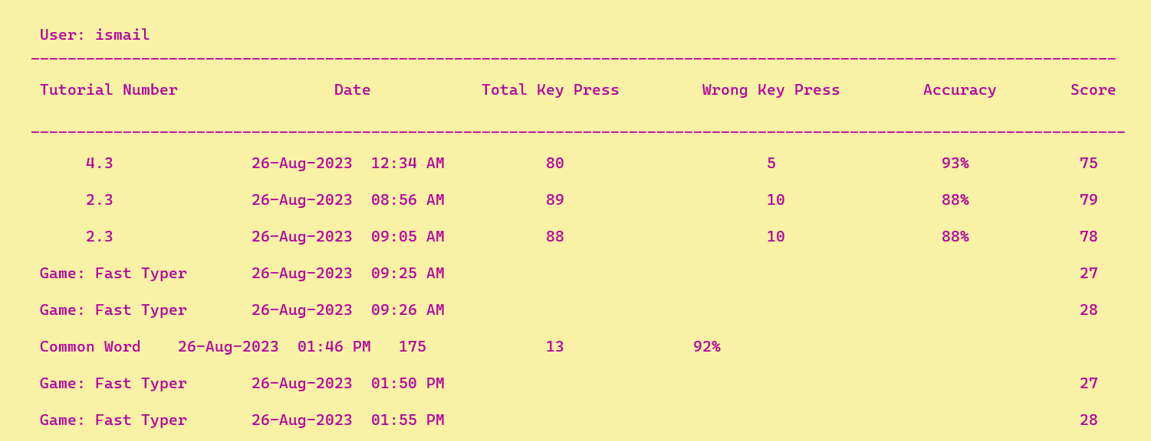
Statistics: Performance History
Users’ performance on each lesson or Game will be stored so that user can check his performance history. It stores Tutorial number, Date, Number of key press, wrong key press, Accuracy, Score.

